Slide 1
AI-Based Automated Answer Sheet Evaluation System
Digital Handwriting Capture & Intelligent Text Digitization
✍️ Digital Handwriting
HTML5 Canvas Stroke Vectors
⚡ FastAPI & PaddleOCR
PP-OCRv5 Microservice
📄 Digitized Text
Structured Machine-Readable Output
➔
➔
TEAM MEMBERS
Joshi Manthan(D25CE155)
PROJECT GUIDE
Dr.Ashwin Makwana
DEPARTMENT
Computer Engineering
ACADEMIC YEAR
2026 – 2027

Slide 2
EXECUTIVE SUMMARY
Project Overview
⚠️ Problem
Traditional handwritten answer-sheet processing is manual, labor-intensive, and difficult to digitize automatically for evaluation workflows.
💡 Solution
Captures digital handwritten responses from canvas interfaces and processes them through an integrated OpenCV + PaddleOCR neural pipeline.
🎯 Current Milestone
Converts handwritten answers into accurate, machine-readable digitized text, laying the foundation for downstream evaluation.
Workflow Summary
PROBLEM (Manual Sheet Handling) ➔ DIGITAL CAPTURE (Canvas Strokes) ➔ OCR PIPELINE (FastAPI + PP-OCRv5) ➔ DIGITIZED TEXT (MongoDB Persistence)

Slide 3
MARKET NEED
Why Digitize Handwritten Answers?
Conventional Answer-Sheet Challenges
• Manual handling and sorting of physical answer sheets
• Time-consuming manual data entry and transcription
• Unstructured handwriting hinders machine processing
• Question-wise answer extraction is difficult on physical paper
• Requires significant human effort prior to evaluation
Process Comparison
TRADITIONAL PROCESS:
Physical Paper ➔ Manual Reading ➔ Manual Entry ➔ Evaluation
PROPOSED SYSTEM:
Digital Handwriting ➔ Image Preprocessing ➔ PaddleOCR ➔ Digitized Text
KEY BENEFIT:
Substantially reduces manual data-entry dependency and creates structured digital records.

Slide 4
SOLUTION OVERVIEW
Proposed Digital Pipeline
STEP 01
Student Writes
Digital pen input
STEP 02
Stroke Capture
(x,y,t) vectors
STEP 03
Answer Image
Render PNG
STEP 04
Preprocessing
CLAHE & Threshold
STEP 05
PaddleOCR
PP-OCRv5 HWR
STEP 06
Digitized Text
MongoDB Store
Core Solution Statement
“Transforming handwritten digital responses into structured, machine-readable text.”

Slide 5
ARCHITECTURE
System Architecture
Microservice Flow
Student Canvas (React 19 + Vite)
│ POST /api/v1/student/answer-sheets
▼
Node.js + Express Backend Server
│ Asynchronous HTTP Payload
▼
FastAPI Python OCR Service (Port 8000)
│ Image Preprocessing & PP-OCRv5
▼
MongoDB Persistence (AnswerSheet Collection)
Component Responsibilities
FRONTEND (React + Vite):
Captures vector strokes and question-wise assignments.
BACKEND (Node.js + Express):
Orchestrates JWT auth, status flow, and async execution.
OCR SERVICE (FastAPI + PaddleOCR):
Executes OpenCV preprocessing & PP-OCRv5 neural inference.
DATABASE (MongoDB):
Persists stroke data, generated images, and extracted text.

Slide 6
WORKFLOW
End-to-End Handwriting Recognition Workflow
STAGE 1: CAPTURE
Collect vector strokes from HTML5 digital answer canvas.
STAGE 2: PREPROCESS
Normalize DPI, CLAHE contrast enhancement, and grayscale thresholding.
STAGE 3: RECOGNIZE
PP-OCRv5 neural model predicts handwritten characters.
STAGE 4: EXTRACT
Generates clean machine-readable text with confidence metrics.

Slide 7
TECH STACK
Technology Stack
FRONTEND
• React 19
• Vite
• Axios Client
• HTML5 Canvas
BACKEND
• Node.js (ESM)
• Express.js
• JWT Security
• Mongoose ODM
OCR / AI
• Python 3.11
• FastAPI
• PaddleOCR 3.7.0
• PP-OCRv5
DATABASE
• MongoDB
• REST APIs
• JSON Payloads
• Modular Architecture

Slide 8
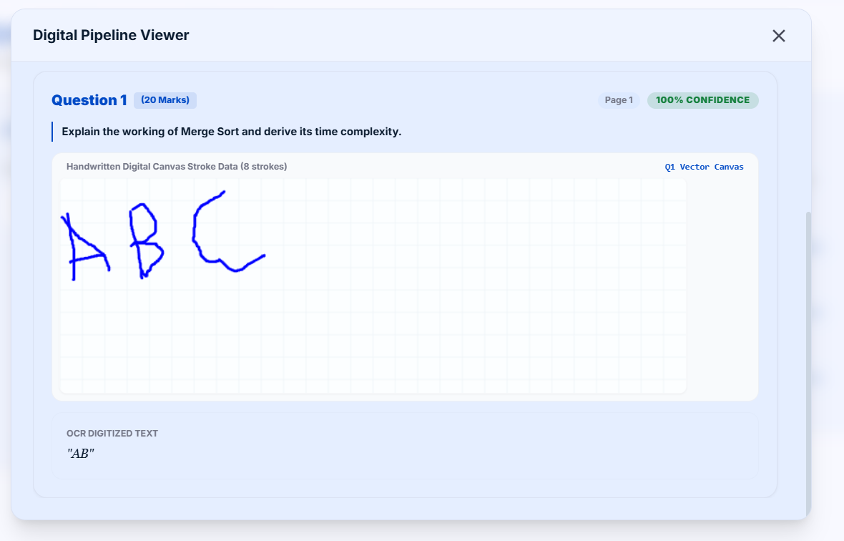
CAPTURE STAGE
Digital Handwritten Answer Capture
Functional Pipeline
01 — WRITE:
Student writes answers directly using digital stylus on responsive canvas.
02 — CAPTURE:
Real-time stroke capture mapped question-by-question with timestamp vectors.
03 — PREPARE:
Renders high-contrast PNG bitmap ready for OCR microservice processing.

Slide 9
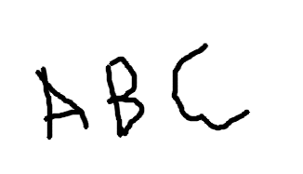
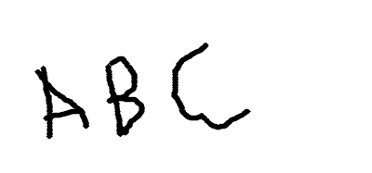


OPENCV PIPELINE
OCR Image Preprocessing Pipeline
1. Raw Render
2. Upscale
3. Grayscale
4. CLAHE
5. Thresholded
Preprocessing Explanations
Resize: Standardizes stroke DPI and thickness. | CLAHE: Enhances stroke boundary contrast.
Thresholding: Separates handwriting strokes cleanly from background noise for neural inference.

Slide 10
HWR MICROSERVICE
PaddleOCR Recognition Engine
Microservice Execution Flow
Processed Answer Image PNG
│
▼
FastAPI POST /api/v1/ocr/recognize-strokes
│
▼
PaddleHWRProvider (PaddleOCR 3.7.0 / PP-OCRv5)
│
▼
Extracted Text String + Confidence Score
│
▼
MongoDB Persistence (AnswerSheet Document)
Microservice Features
• RESTful API-based microservice architecture
• Python 3.11 FastAPI high-throughput server
• PaddleOCR PP-OCRv5 mobile recognition neural head
• Lazy engine loading to preserve system RAM
• Structured JSON response with confidence scoring

Slide 11
CORE DEMONSTRATION
Handwritten Answer → Digitized Text
INPUT: HANDWRITTEN CANVAS STROKES
OCR Digitized Text
"AB"
OUTPUT: DIGITIZED TEXT (PADDLEOCR)
Core Milestone
Digital handwriting successfully transformed into machine-readable text.

Slide 12
API OUTPUT
OCR API Response Payload
JSON Response Payload
{
"success": true,
"message": "Handwriting recognition completed.",
"data": {
"answerSheetId": "6a97c197883c3047ee452bed",
"provider": "paddle",
"executionTimeSec": 82.84,
"overallConfidence": 0.6137,
"extractedText": "Q1: ADDLE OLR PERSISTENTE (",
"answers": [{
"questionId": "q1",
"recognizedText": "ADDLE OLR PERSISTENTE (",
"hwrStatus": "Completed"
}]
}
}
Field Explanations
extractedText:
Concatenated transcribed text stored in MongoDB.
confidence:
Neural confidence metric generated by PP-OCRv5 head.
executionTimeSec:
Total latency for stroke rendering & inference.
hwrStatus:
Completion flag for background job polling.

Slide 13
VALIDATION
System & Pipeline Validation
Verified Acceptance Criteria
✓ Canvas strokes correctly rendered to image files
✓ FastAPI OCR microservice returns 200 OK
✓ PaddleOCR engine executes real neural inference
✓ Transcribed text persisted into MongoDB
✓ Digitized text bound to Faculty UI display
Microservice Features
• RESTful API-based microservice architecture
• Python 3.11 FastAPI high-throughput server
• PaddleOCR PP-OCRv5 mobile recognition neural head
• Lazy engine loading to preserve system RAM
• Structured JSON response with confidence scoring

Slide 14
ROADMAP
Current Status & Next Phase
Completed Milestone 1 [Achieved]
✓ Digital Answer Stroke Capture
✓ OpenCV Image Preprocessing
✓ FastAPI PaddleOCR Integration
✓ Neural Handwriting Recognition
✓ Machine-Readable Text Digitization
Next Phase [Future Scope]
Digitized Text
│
▼
Semantic Answer Understanding (LLM Prompting)
│
▼
Model Answer Comparison & Rubrics
│
▼
Automated Marking & Faculty Review Interface

Slide 15
CONCLUSION
From Handwriting to Machine-Readable Text
1. Digital First
Captures handwritten responses directly from digital slates, eliminating physical paper scanning and logistics.
2. Intelligent Digitization
Leverages state-of-the-art PaddleOCR PP-OCRv5 neural models for robust handwriting digitization.
3. AI-Ready Data
Converts raw student handwriting into structured machine-readable text ready for automated downstream pipelines.
Closing Statement
“From Digital Handwriting to Machine-Readable Knowledge.”

